Slide 1
DATA STRUCTURE & ALGORITHM
Presentation on Real World Application
Presentation by:
MIMANSHA (RA2211042010030)
AYUSH JAISWAL (RA2211042010020)
ARYAN SINGH (RA2211042010003)

Slide 2
TABLE OF CONTENTS
01
02
03
PROBLEM & SOLUTION
OUR PROCESS
OUTPUT
How to buffer through a music system easily?
DS implementation with function and C Language code.
How the result will look like.

Slide 3
PROBLEM & SOLUTION
While listening to music, how should one skip to another song? Or add their favourite song to the queue, search for new artists, remove any song or exit the music player?
The most effective and easy solution to this is by using DATA STRUCTURE
The Data Structure we can use is DOUBLY LINKED LIST, STACK & QUEUES to make any music playing application better and customer-friendly.
File handling to read and write songs has also been used for this problem statement.

Slide 4
WHAT ARE DLL, STACK & QUEUES?
A doubly linked list (DLL) is a special type of linked list in which each node contains a pointer to the previous node as well as the next node of the linked list.
Stack is a linear data structure that follows a particular order in which the operations are performed. The order may be LIFO(Last In First Out) or FILO(First In Last Out). LIFO implies that the element that is inserted last, comes out first and FILO implies that the element that is inserted first, comes out last.
A Queue is defined as a linear data structure that is open at both ends and the operation are performed in First In First Out (FIFO) order.

Slide 5
OUR PROCESS
SOFTWARE REQUIREMENT
CODE BLOCKS 13.12
or
DEV C++ 5.11

Slide 6
MAIN FUNCTIONS REQUIREMENT
del_node()
tofile()
display()
add_node()
Function that deletes the last song from the input linked list.
Function to work on playslist.txt.
Function to display the stack generated in push() function.
Function that adds songs to the list using a linked list.

Slide 7
OTHER FUNCTIONS
add_node_file() –
Function that adds songs to the playlist to linked list from the data passed in addplaylist() function.
delete_file() –
Function to delete song from text file playlist.txt.
printlist() –
Function that displays the input songs of the playlist.
topelement() – Function that displays the last played song.

Slide 8
recent() - Function that calls display() function.
addplaylist() – Function that opens text file playlist.txt and passes data to add_node_file() function.
del_search() – Function to search input song and delete it from the list.
deletemenu() – Function to invoke del_search() or del_pos() functions depending on user input.
main() – Function that invokes all other functions of the project based on user defined input.

Slide 9
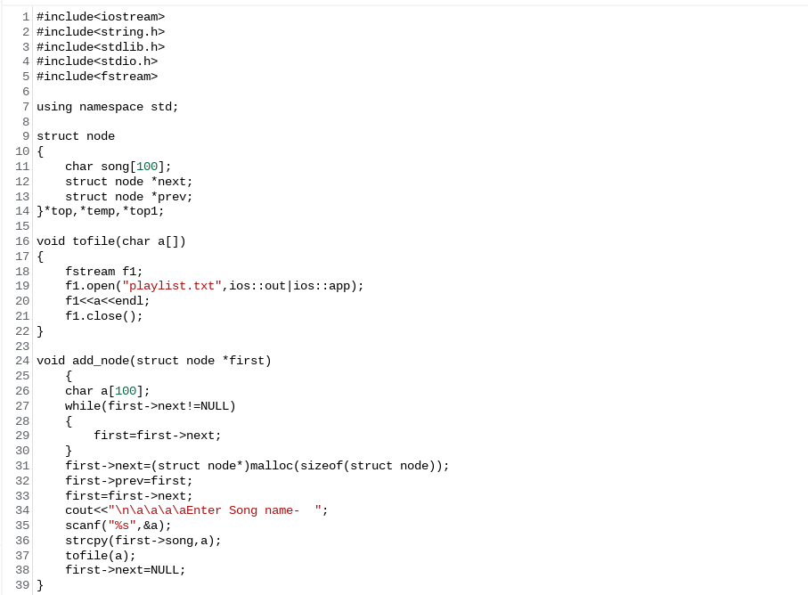
IMPLEMENTATION IN C++ LANGUAGE
f1.close();
}
void add_node(struct node *first)
{
char a[100];
while(first->next!=NULL)
{
first=first->next;
}
first->next=(struct node*)malloc(sizeof(struct node));
first->prev=first;
first=first->next;
cout<<"\n\a\a\a\aEnter Song name- ";
scanf("%s",&a);
strcpy(first->song,a);
tofile(a);
first->next=NULL;
}
void add_node_file(struct node *first,string a)
{
while(first->next!=NULL)
{
first=first->next;
}
first->next=(struct node*)malloc(sizeof(struct node));
first->prev=first;
first=first->next;
strcpy(first->song,a.c_str());
first->next=NULL;
}
void delete_file(char a[])
{
fstream f1,f2;
string line;
int x=0;
f1.open("playlist.txt",ios::in|ios::out);
f2.open("temp.txt",ios::in|ios::out);
while(!f1.eof())
{
getline(f1,line);
if(strcmp(a,line.c_str())!=0)
f2<<line<<endl;
else if (strcmp(a,line.c_str())==0)
x=1;
}
f1.close();
f2.close();
remove("playlist.txt");
rename("temp.txt","playlist.txt");
if(x==0)
{
cout << "There is no song with name you entered." << endl;
}
else
{
cout << "Song has been deleted." << endl;
}
}
void del_node(struct node *first)
{
while((first->next)->next!=NULL)
{
first=first->next;
}
struct node *temp;
temp=(first->next)->next;
first->next=NULL;
free(temp);
cout<<"Deleted"<<endl;
}
void printlist(struct node *first)
{
cout<<"\nPlaylist Name- ";
while(first->next!=NULL)
{
cout<<first->song<<endl;
first=first->next;
}
cout<<first->song<<endl;
}
void count_nodes(struct node *first)
{
int i=0;
while (first->next!=NULL)
{
first=first->next;
i++;
}
i++;
cout<<"\nTotal songs- "<<i-1<<endl;
}
struct node *del_pos(struct node *pointer, int pos)
{
struct node *n1,*prev1,*temp;
prev1= ( struct node *)malloc(sizeof(node));
temp= (struct node *)malloc(sizeof(node));
int i=0;
if(pos==1)
{
temp=pointer;
delete_file(temp->song);
pointer=pointer->next;
pointer->prev = NULL;
free(temp);
printf("\nThe list is updated\nUse the display function to check\n");
return pointer;
}
while(i<pos-1)
{
prev1=pointer;
pointer=pointer->next;
i++;
}
if(pointer->next==NULL)
{
temp=pointer;
delete_file(temp->song);
prev1->next->prev=NULL;
prev1->next=NULL;
free(temp);
printf("\nThe list is updated\nUse the display function to check\n");
}
else
{
temp=pointer;
delete_file(temp->song);
prev1->next=temp->next;
temp->next->prev=prev1;
free(temp);
printf("\nThe list is updated\nUse the display function to check\n");
}
}
void search1(struct node *first)
{
char song[100];
cout<<"\n\a\a\a\aEnter song To be Searched- ";
scanf("%s",&song);
int flag=0;
while(first!=NULL)
{
if(strcmp(first->song,song)==0)
{
cout<<"\n\a\a\a\a#Song Found"<<endl;
flag++;
break;
}
else
{
first=first->next;
}
}
if(flag==0)
{
cout<<"\n\a\a\a\a#Song Not found"<<endl;
}
}
void create()
{
top = NULL;
}
void push(char data[])
{
if (top == NULL)
{
top =(struct node *)malloc(sizeof(struct node));
top->next = NULL;
strcpy(top->song,data);
}
else if (strcmp(top->song,data)!=0)
{
temp =(struct node *)malloc(sizeof(struct node));
temp->next = top;
strcpy(temp->song,data);
top = temp;
}
}
void display()
{
top1 = top;
if (top1 == NULL)
{
printf("\n\a\a\a\a=>NO recently played tracks.\n");
return;
}
printf("\n\a\a\a\a#Recently played tracks-\n");
while (top1 != NULL)
{
printf("%s", top1->song);
printf("\n");
top1 = top1->next;
}
}
void play(struct node *first)
{
char song[100];
printlist(first);
cout<<"\n\a\a\a\aChoose song you wish to play- ";
scanf("%s",song);
int flag=0;
while(first!=NULL)
{
if(strcmp(first->song,song)==0)
{
cout<<"\n\a\a\a\a=>Now Playing......"<<song<<endl;
flag++;
push (song);
break;
}
else
{
first=first->next;
}
}
if(flag==0)
{
cout<<"\n\a\a\a\a#Song Not found"<<endl;
}
}
void recent()
{
display();
}
void topelement()
{
top1=top;
if(top1==NULL)
{
printf("\n\a\a\a\a#NO last played tracks.\n");
return;
}
cout<<"\n=>Last Played Song - "<<top->song<<endl;
}
void sort( node *&pointer)
{
struct node *a = NULL;
struct node *b = NULL;
struct node *c = NULL;
struct node *e = NULL;
struct node *tmp = NULL;
while(e != pointer->next)
{
c = a = pointer;
b = a->next;
while(a != e)
{
if(strcmp(a->song,a->song))
{
if(a == pointer)
{
tmp = b -> next;
b->next = a;
a->next = tmp;
pointer = b;
c = b;
}
else
{
tmp = b->next;
b->next = a;
a->next = tmp;
c->next = b;
c = b;
}
}
else
{
c = a;
a = a->next;
}
b = a->next;
if(b == e)
e = a;
}
}
}
void addplaylist(struct node *start)
{
fstream f1;
string line;
f1.open("playlist.txt",ios::in);
while(!f1.eof())
{
getline(f1,line);
add_node_file(start,line);
}
cout<<"Playlist Added"<<endl;
f1.close();
}
void del_search(struct node *start)
{
char song[100];
printlist(start);
cout<<"\n\a\a\a\aChoose song you wish to delete- ";
scanf("%s",song);
int flag=0;
while(start!=NULL)
{
if(strcmp(start->song,song)==0)
{
cout<<"\n\a\a\a\a#Song Found"<<endl;
struct node *temp;
temp= (struct node *)malloc(sizeof(node));
temp=start;
delete_file(temp->song);
temp->prev->next=temp->next;
temp->next->prev=temp->prev;
free(temp);
flag++;
break;
}
else
{
start=start->next;
}
}
if(flag==0)
{
cout<<"\n\a\a\a\a#Song Not found"<<endl;
}
}
void deletemenu(struct node *start)
{
int c;
cout<<"Which type of delete do you want?\n1.By Search\n2.By Position"<<endl;
cin>>c;
switch(c)
{
case 1:del_search(start);
break;
case 2:int pos;
printf("\nEnter the pos of the song : ");
scanf("%d",&pos);
del_pos(start,pos-1);
break;
}
}
main()
{
int choice,loc;
char song[100];
struct node *start,*hold;
start=(struct node *) malloc(sizeof(struct node));
cout<<"\t\t\t\a\a\a\a**WELCOME**"<<endl;
cout<<"\n**please use '_' for space."<<endl;
cout<<"\n\n\a\a\a\aEnter your playlist name- ";
cin.getline(start->song,100);
start->next=NULL;
hold=start;
create();
do{
cout<<"\n1.Add New Song\n2.Delete Song\n3.Display Entered Playlist\n4.Total Songs\n5.Search Song\n6.Play Song\n7.Recently Played List\n8.Last Played\n9. Sorted playlist\n10.Add From File\n11.Exit"<<endl;
cout<<("\n\a\a\a\aEnter your choice- ");
cin>>choice;
switch(choice)
{
case 1:add_node(start);
break;
case 2:deletemenu(start);
break;
case 3:printlist(start);
break;
case 4:count_nodes(hold);
break;
case 5:search1(start);
break;
case 6:play(start);
break;
case 7:recent();
break;
case 8:topelement();
break;
case 9:sort(start->next);
printlist(start);
break;
case 10:addplaylist(start);
break;
case 11:exit(0);
}
}while(choice!=11);
}

Slide 10
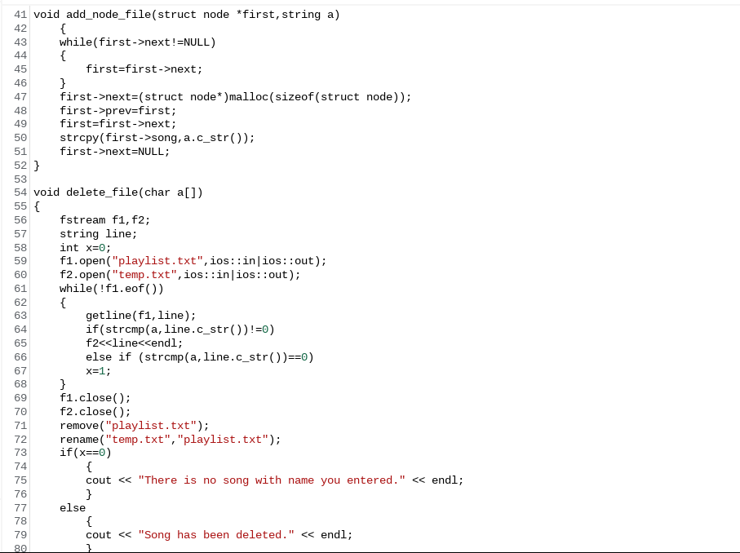

Slide 11
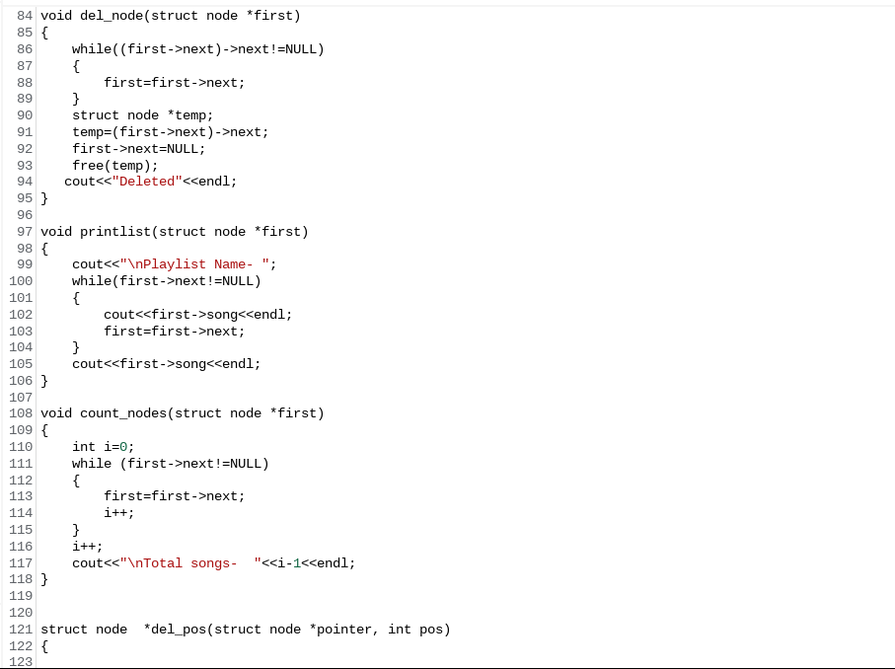

Slide 12
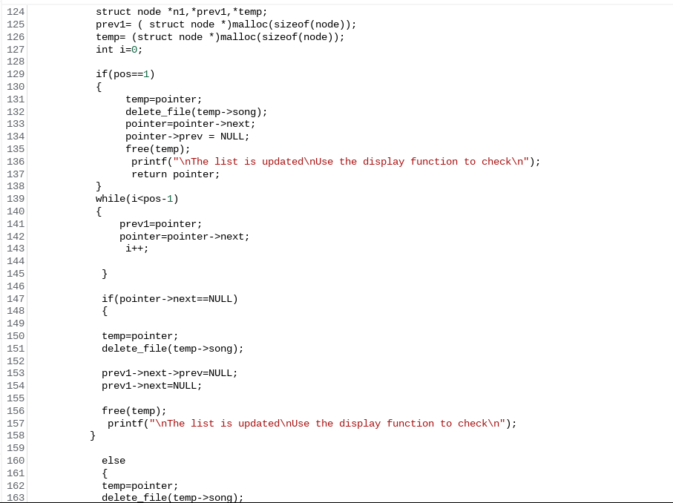

Slide 13
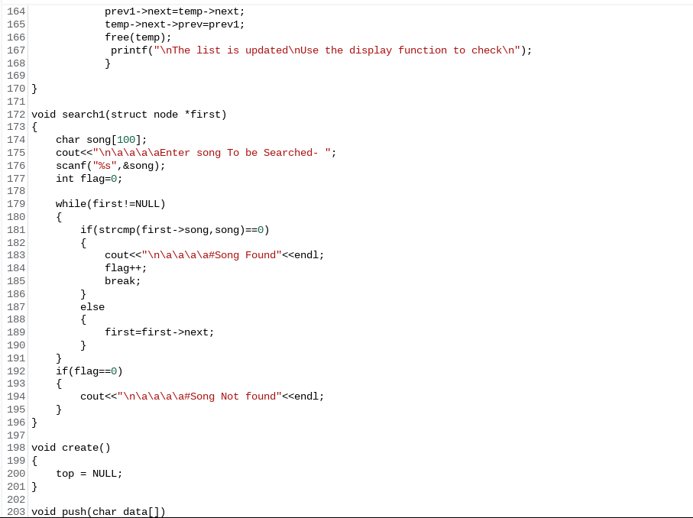

Slide 14
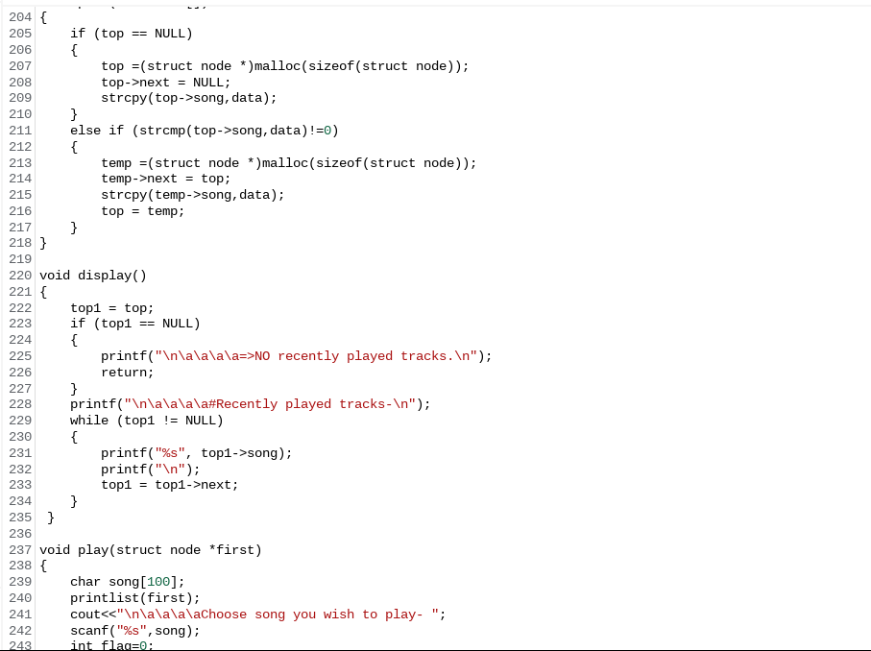

Slide 15
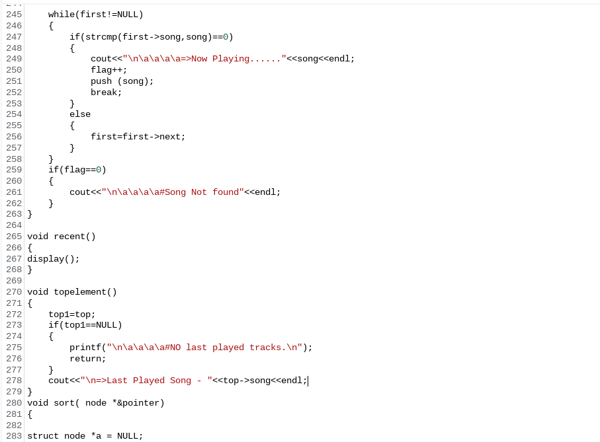

Slide 16
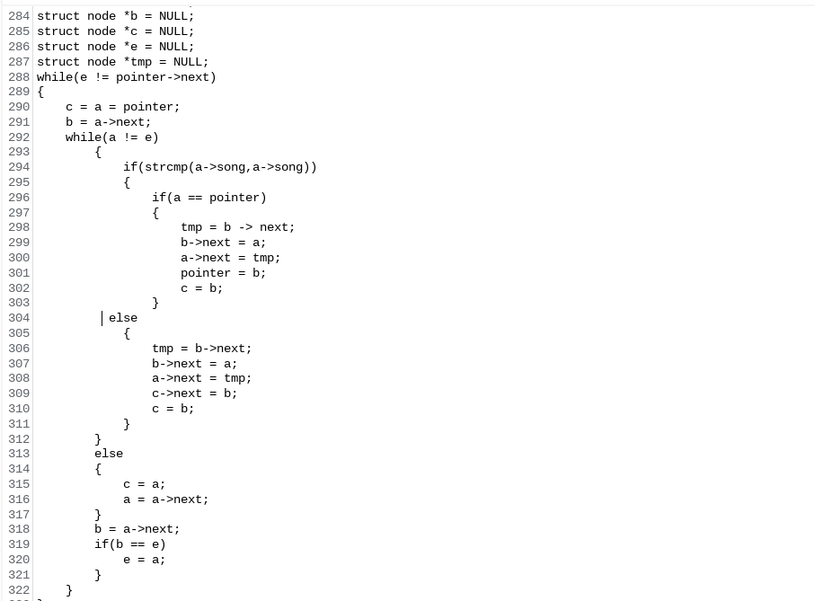

Slide 17
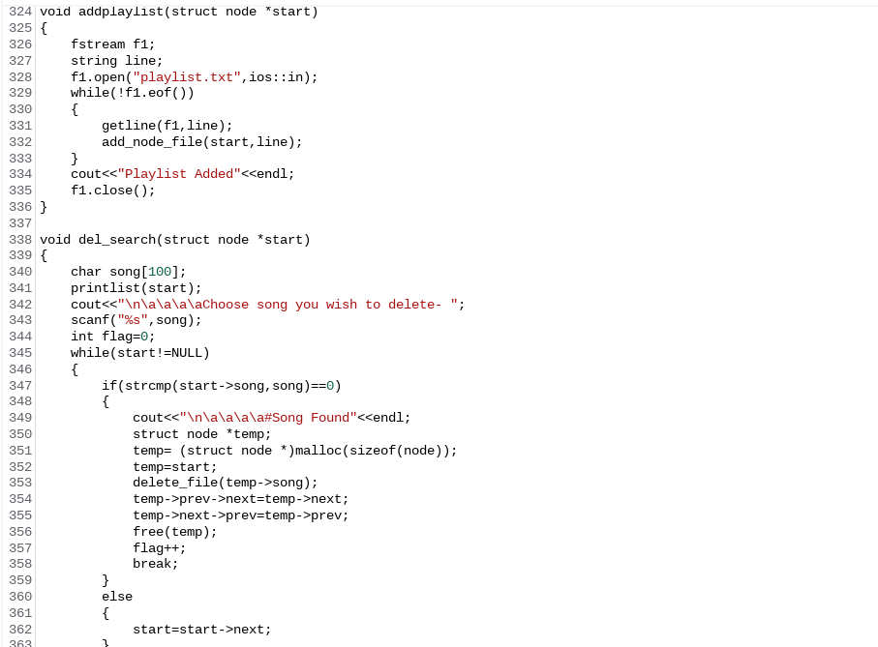

Slide 18
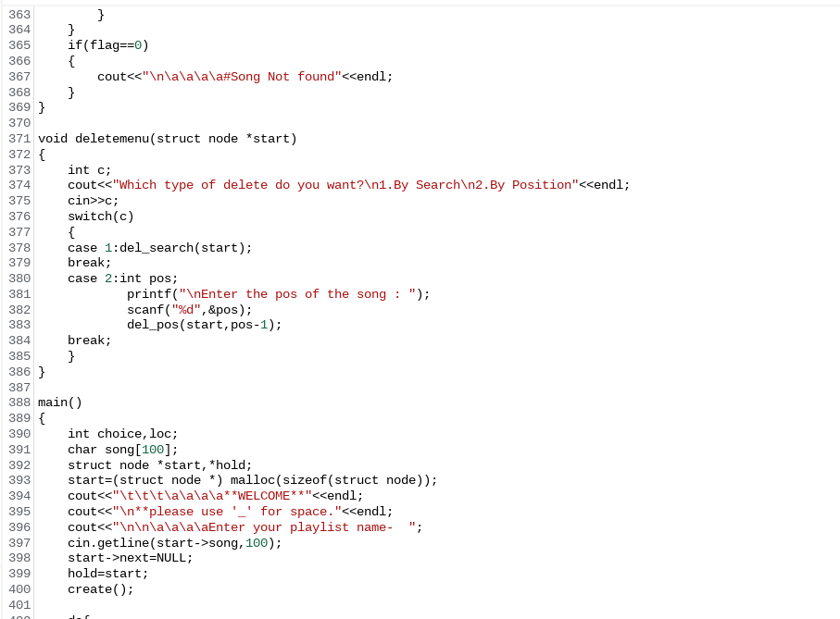

Slide 19
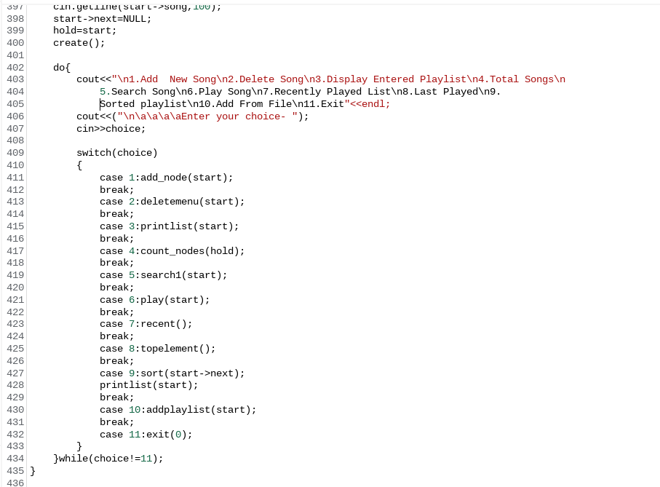

Slide 20
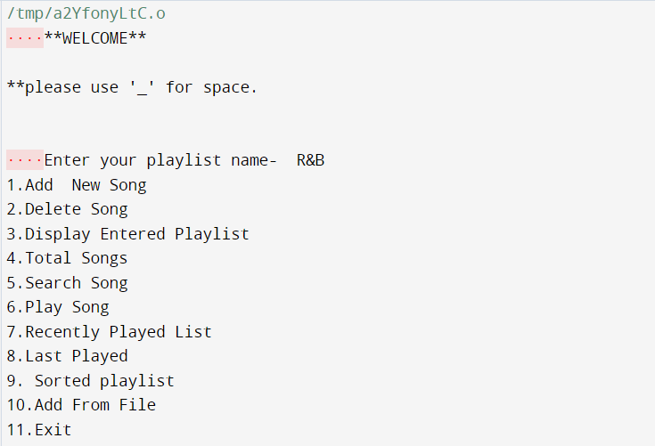
OUTPUT SCREENSHOTS

Slide 21
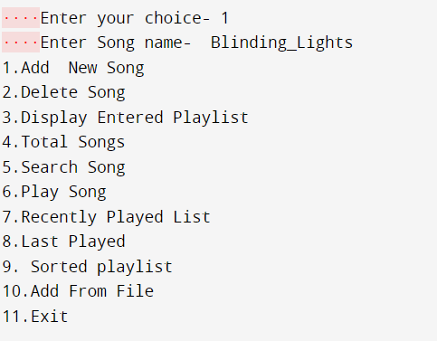
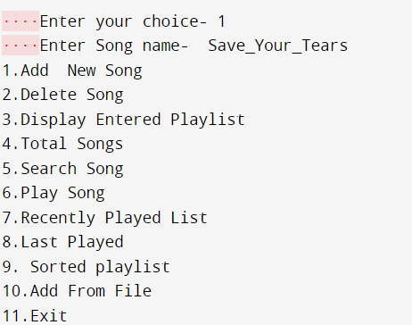
Operation 1) Add New Song

Slide 22
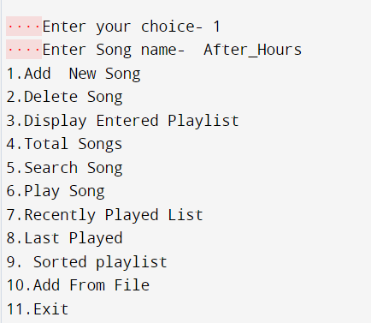
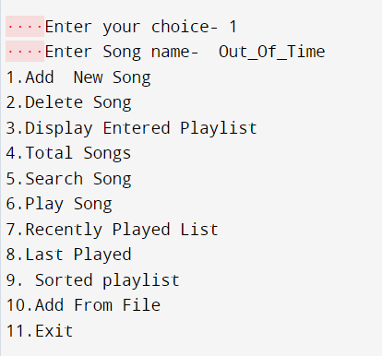

Slide 23
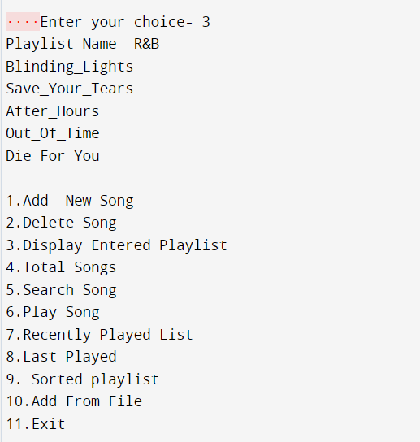
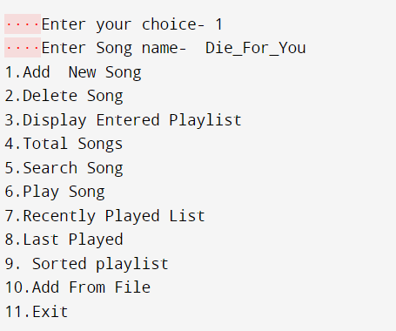
Operation 2) Display Playlist

Slide 24
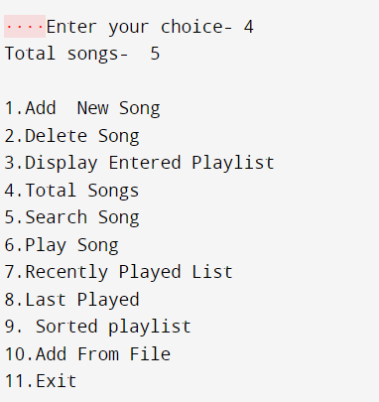
Operation 3) Total Number Of Songs

Slide 25
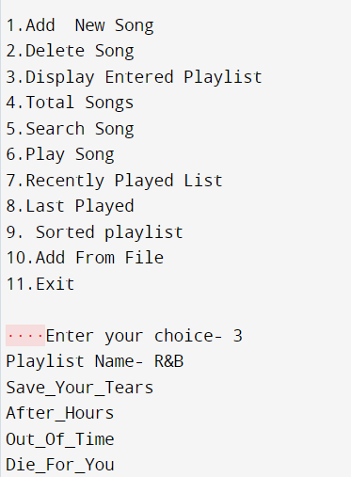
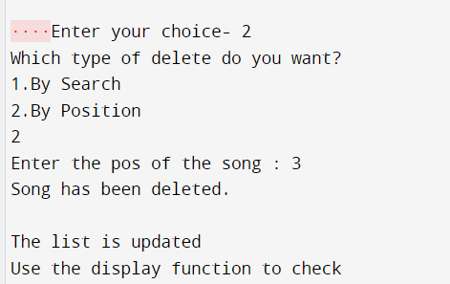
Operation 4) Deleting A Song

Slide 26
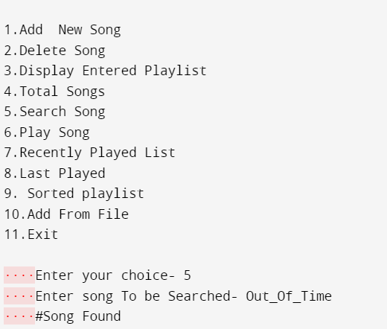
Operation 5) Searching A Song

Slide 27
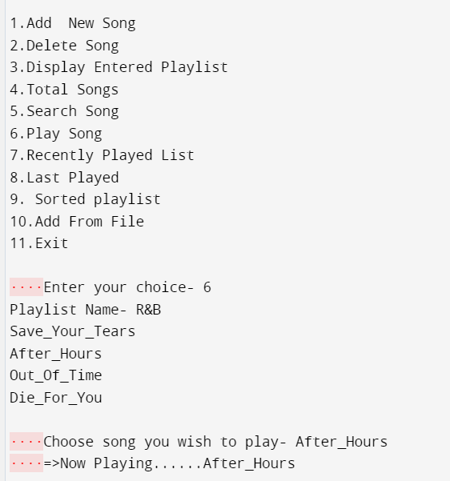
Operation 6) Playing
A Song

Slide 28
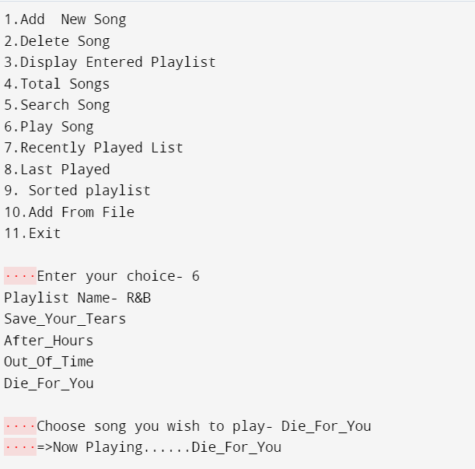

Slide 29
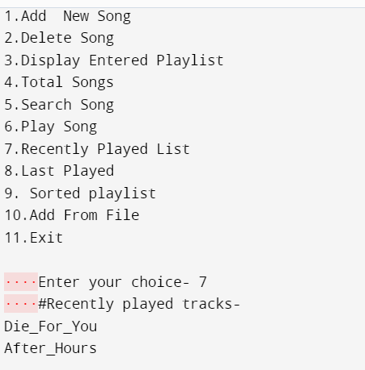
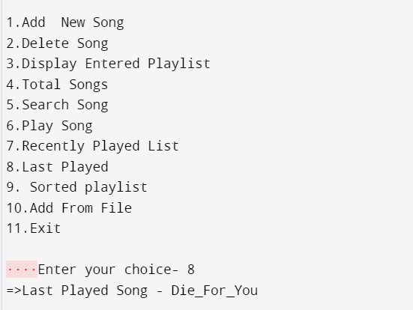
Operation 7) Check Last Played Song
Operation 8) Show Recently Played List

Slide 30
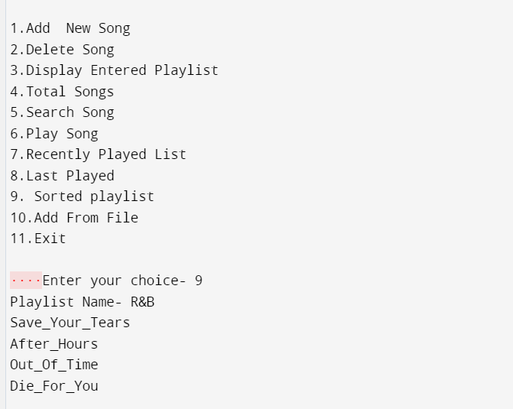
Operation 9) Show Sorted Playlist

Slide 31
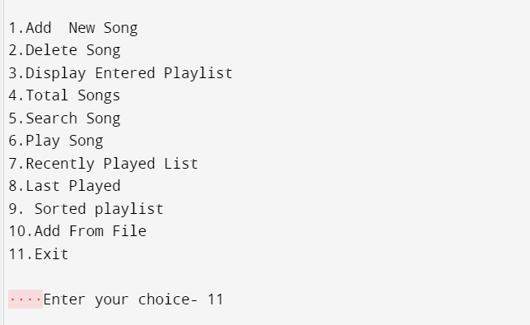
Operation 10) Exit

Slide 32
THANKS

